Slide 1
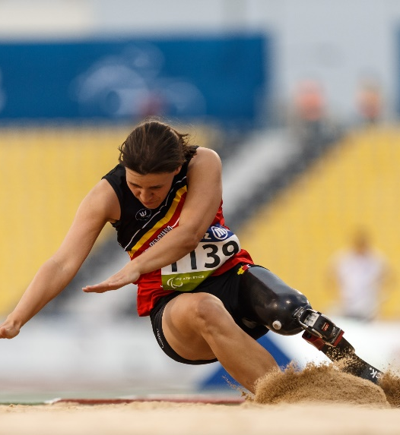
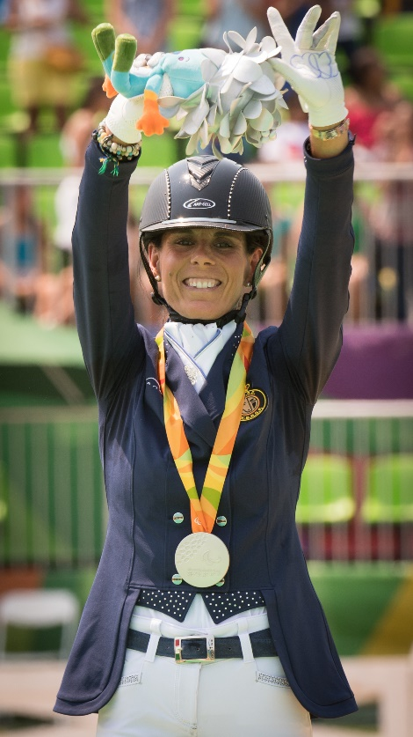
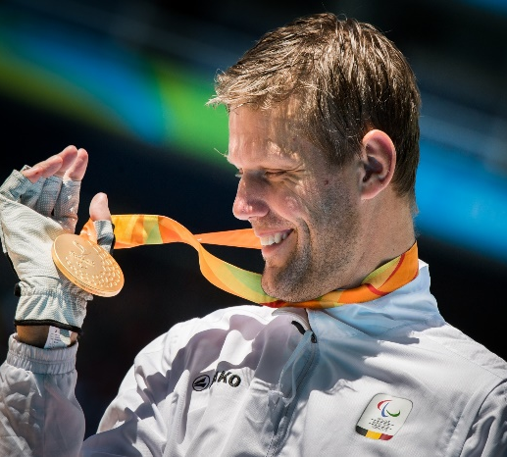
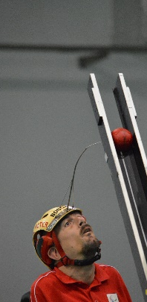
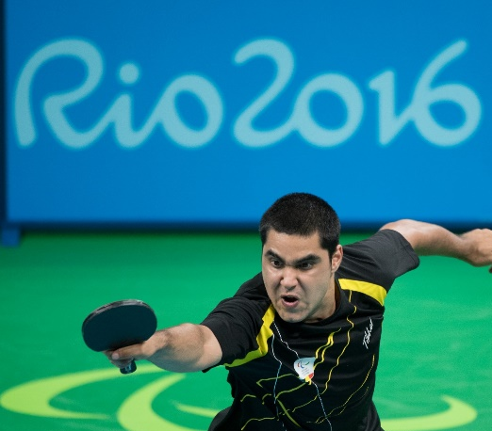
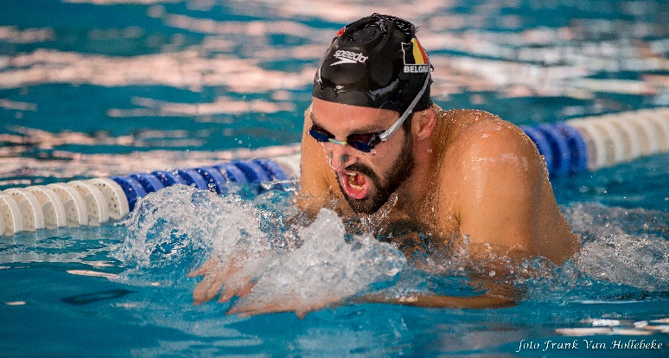
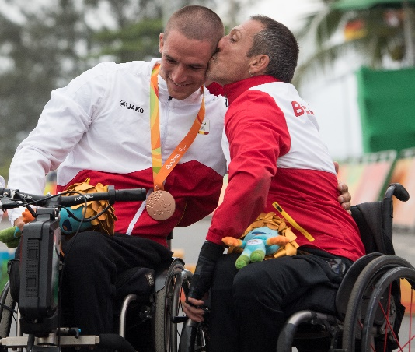
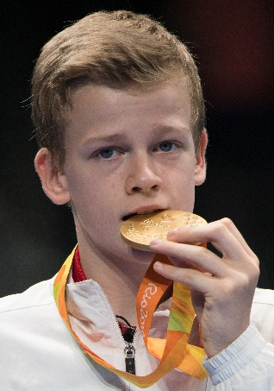
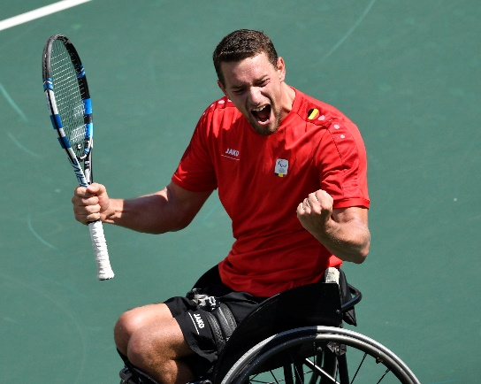
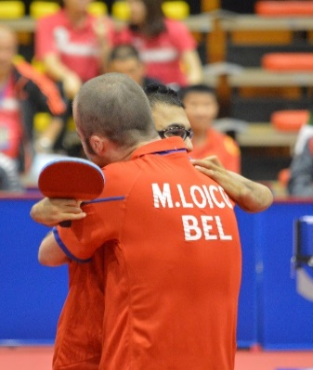
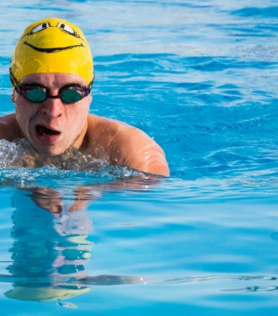
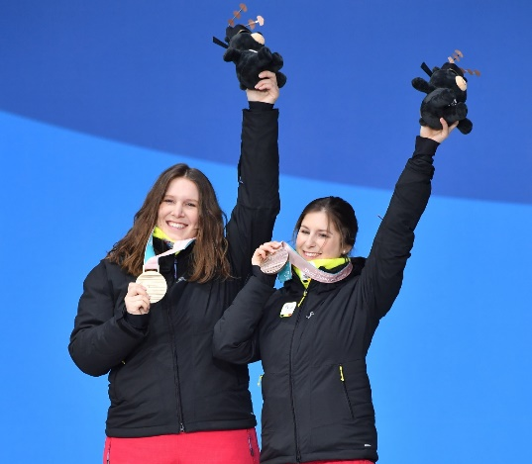
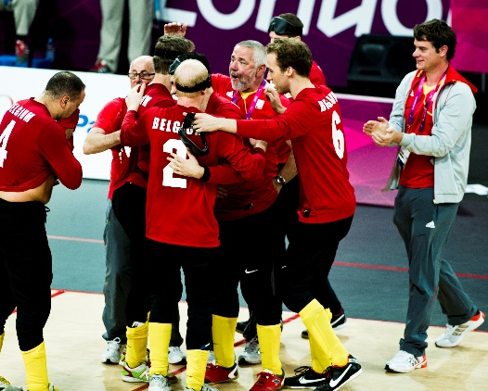
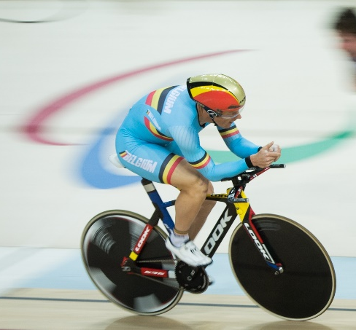
BPC – RTBF
Road to Tokyo 2020

Slide 2
Offer disabled all the opportunities to excell in their sports, for them to become a source of inspiration for the Belgian society thanks to their performances.
72%
Para-sports is perceived as the sports with the strongest growth in the near future
(IPC-Repucom 2015)
72%
Para-sports is perceived as the sports with the strongest growth in the near future
(IPC-Repucom 2015)
72%
Para-sports is perceived as the sports with the strongest growth in the near future
(IPC-Repucom 2015)
Ensure the necessary fundings for the disability sports movement in Belgium to achieve its objectives
Represent our country on international level and promote the paralympic values in our country
Contribute to the personal development of sportsmen/women with a disability

Slide 3
Incomparable organisation
ALL handicaps
ALL
levels
Only governing body incorporating all :
* Physical
* Visual
* Intellectual
* Auditive (limited)
Recognised for all sporting levels :
* Access to sports
* Recreational
* Competitions
* Top-class sports
NPC
Umbrella
National Paralympic Committee for Belgium :
* Preparing Games
* Representing Paralympic brand & values
* Representing Belgium on international level
National cupola of the individual
para sports in Belgium :
* National teams
* Belgian Championships
* Competitions
* Talent detection
* Develop new sports
* Sports-for-all
* Clubs, members

Slide 4
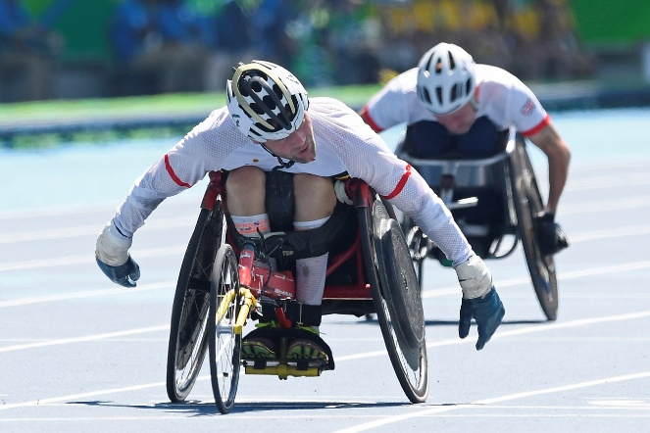
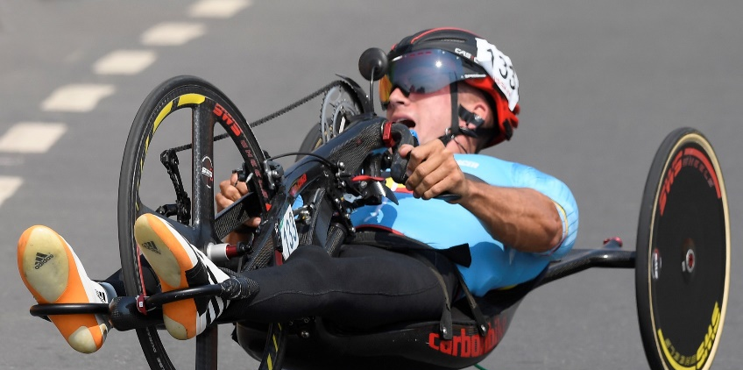
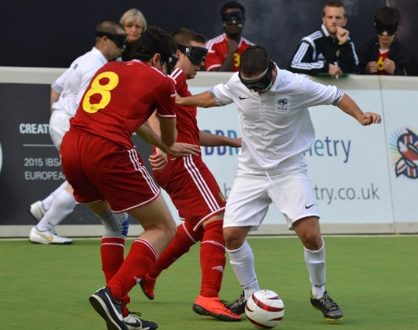
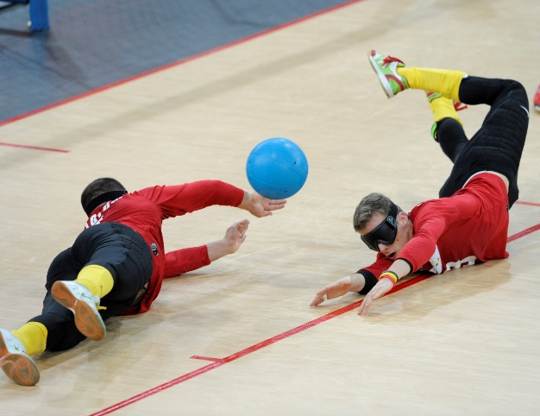
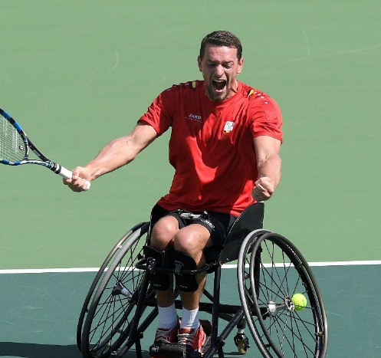
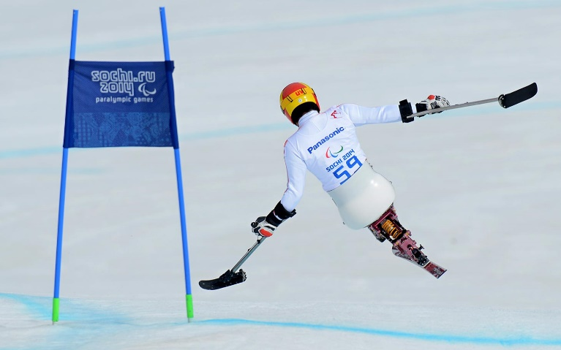
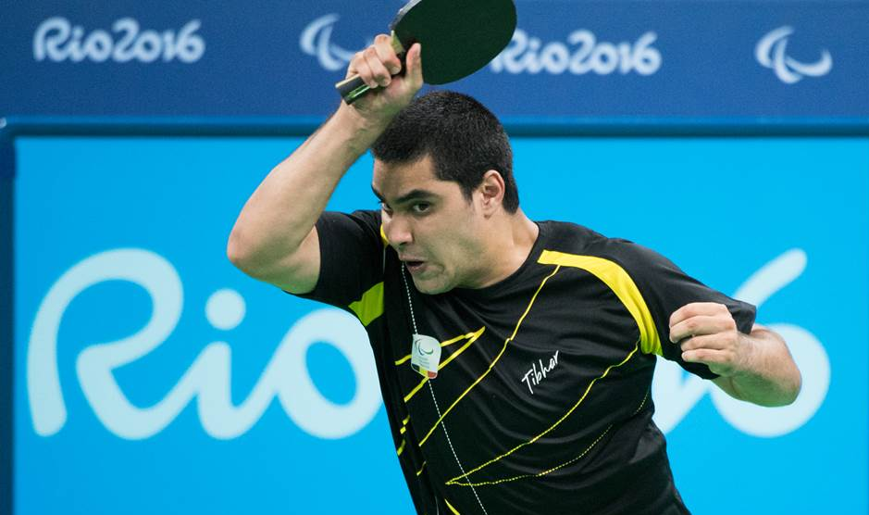
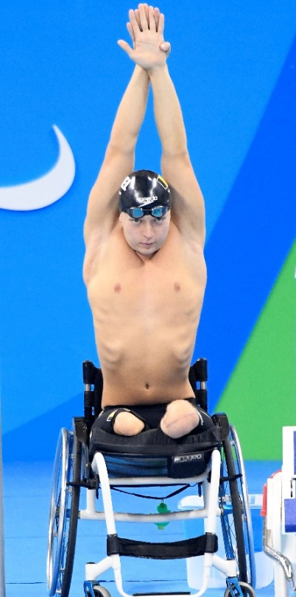
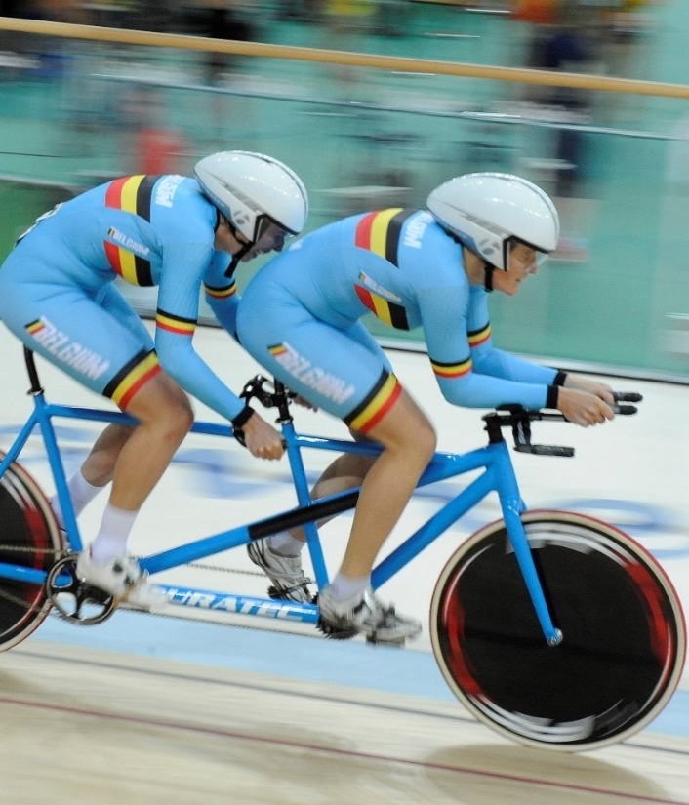
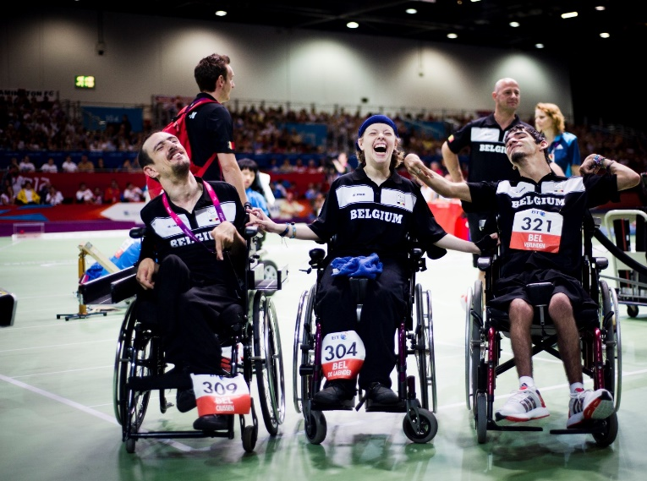
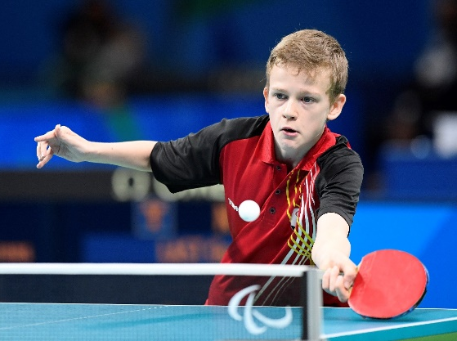
Disabilities represented at the Games :
Physical
Visual
Intellectual

Slide 5
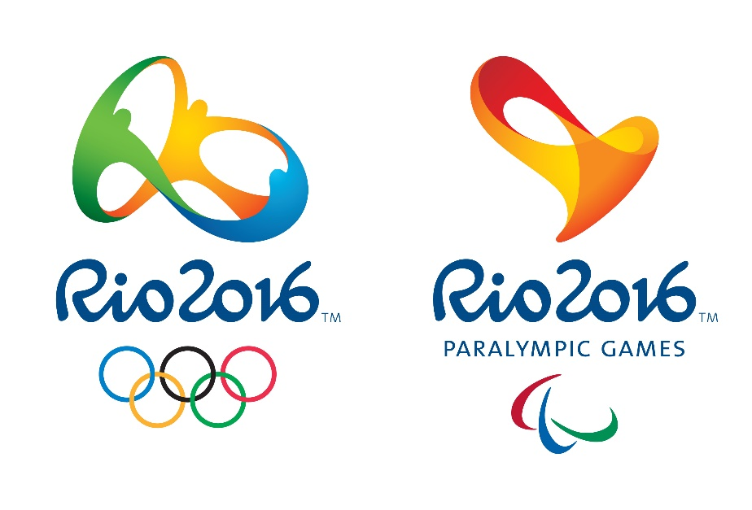
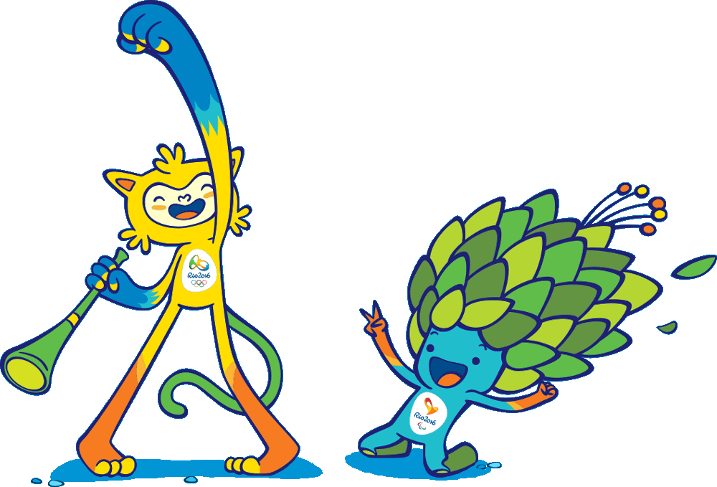
Paralympic Games ?
From “Olympics for paralysed” = focus on disability
To “para-Olympics” = parallel to Olympics = focus on sports
Same city, same venues as Olympics
Same organising committee
3rd biggest sport event in the world

Slide 6
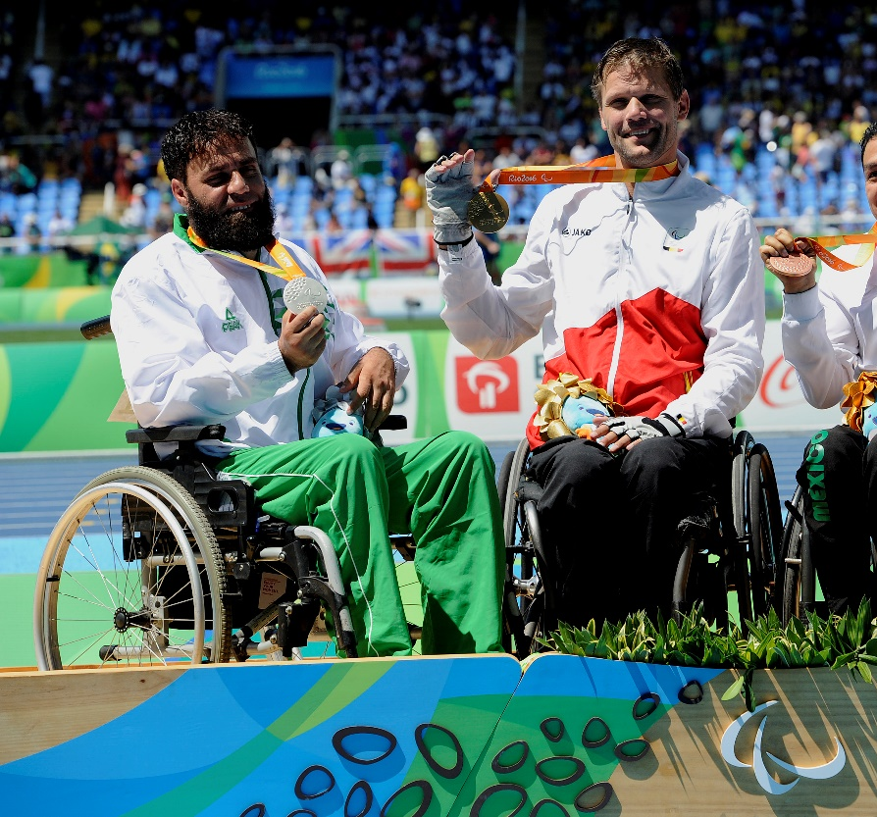
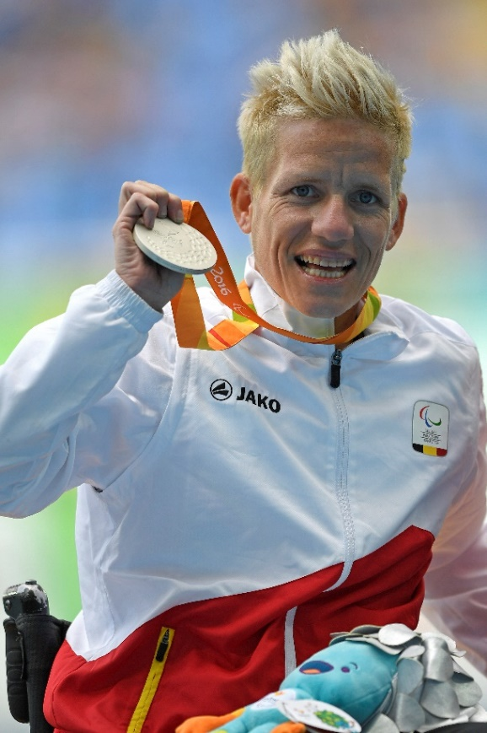
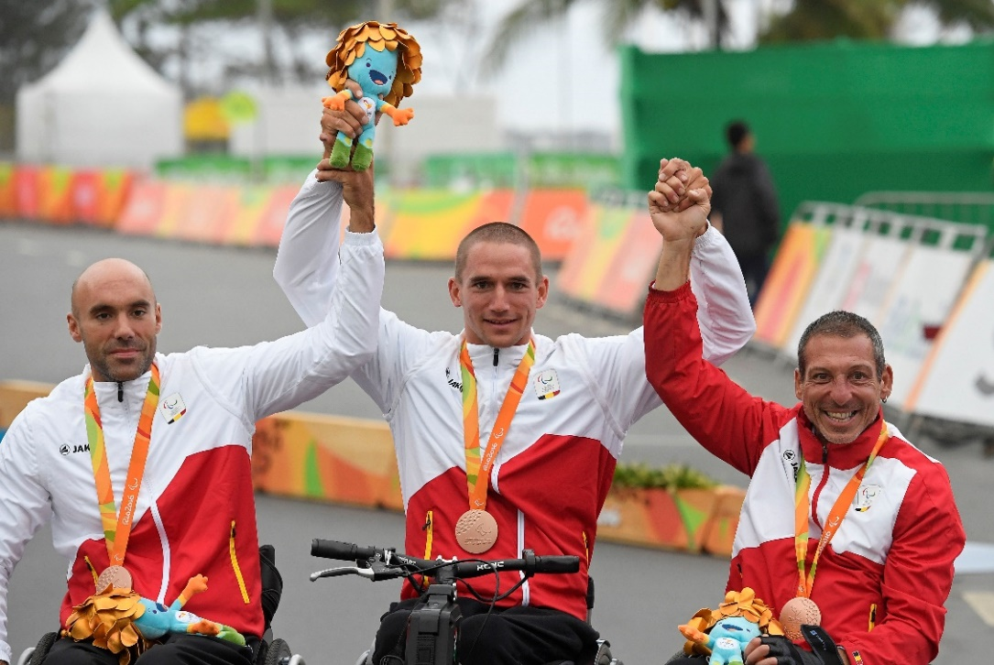
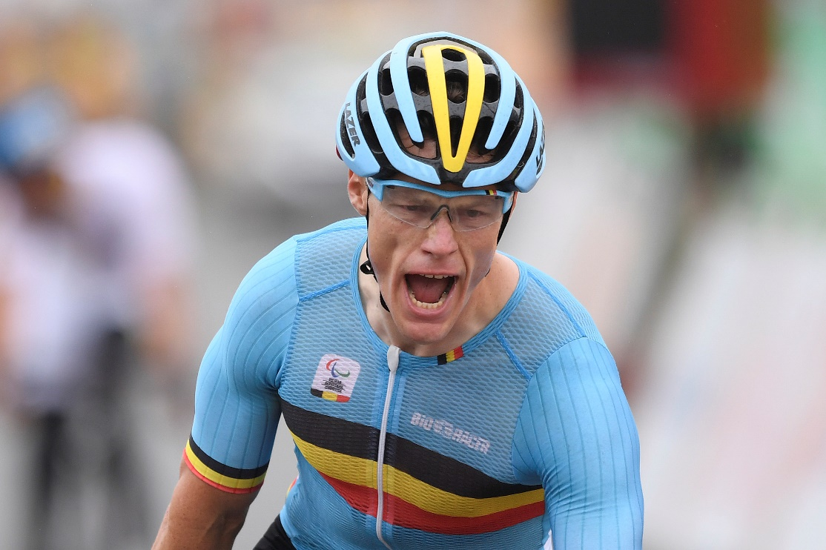
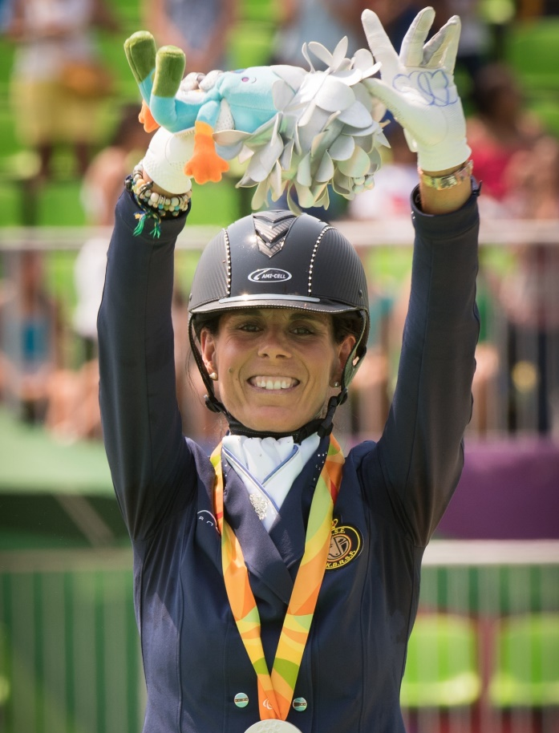
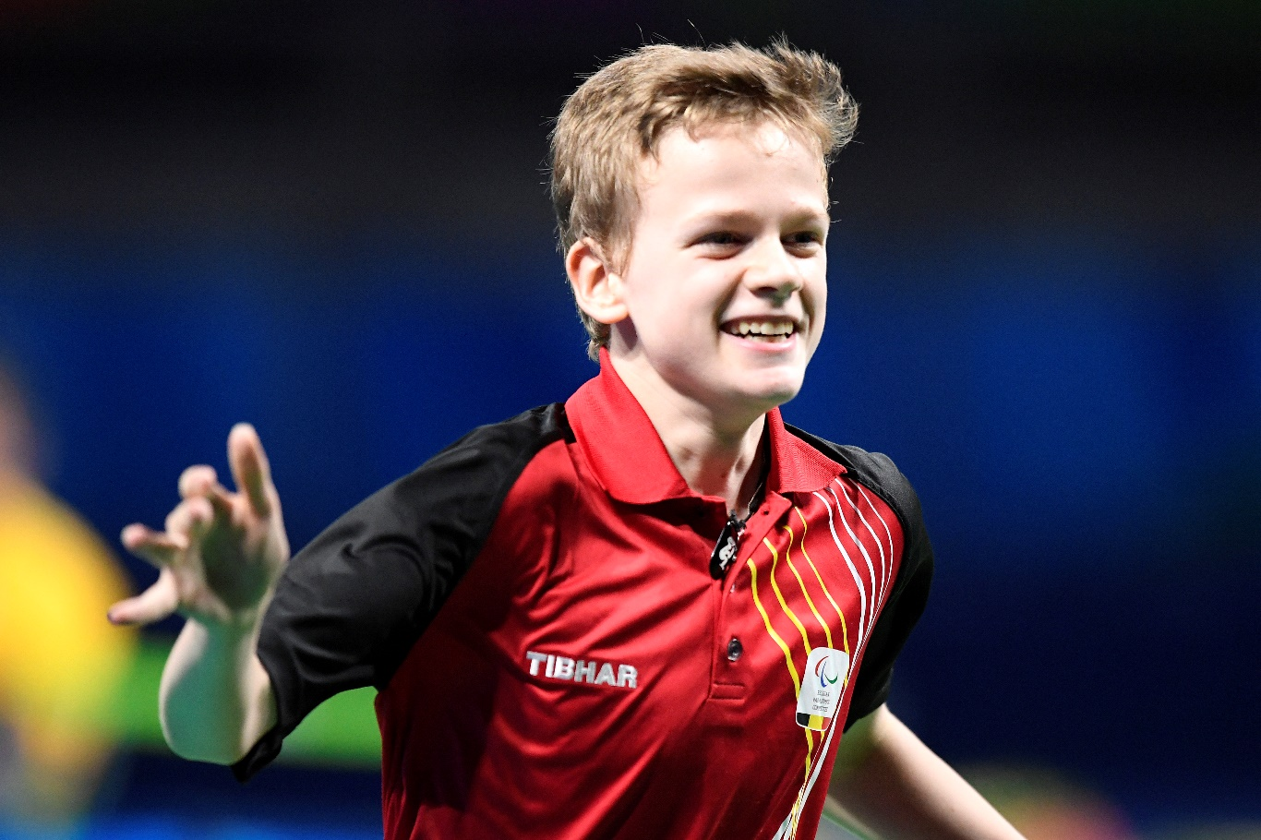
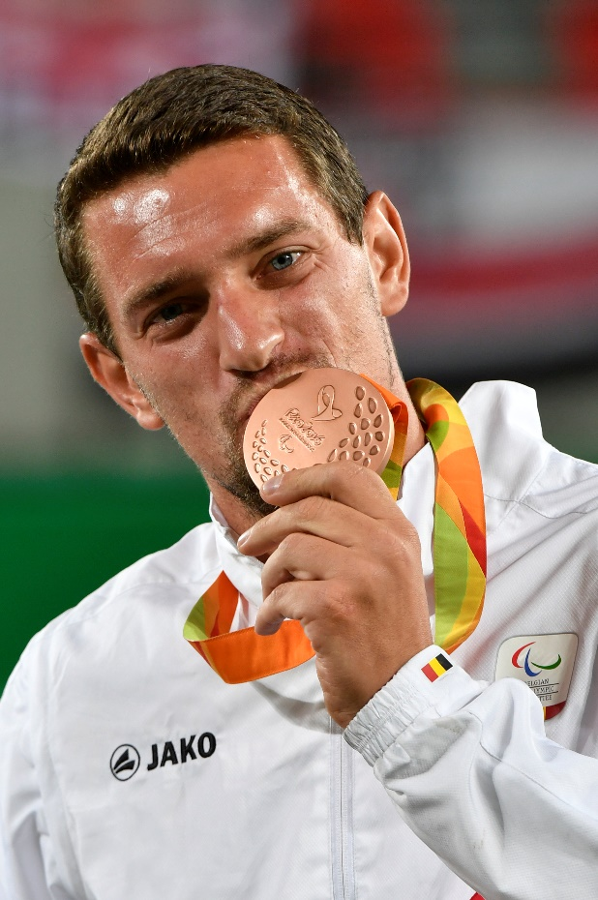
Rio 2016 Paralympic Team Belgium
29 athletes - 11 medals - 5 Paralympic titles - 25th in world ranking

Slide 7
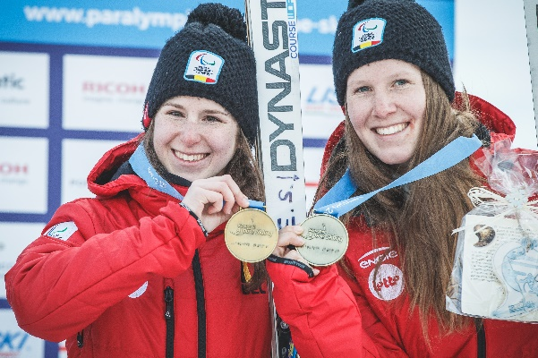
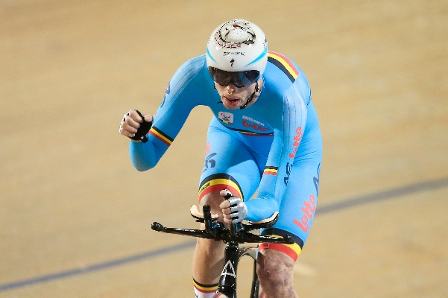
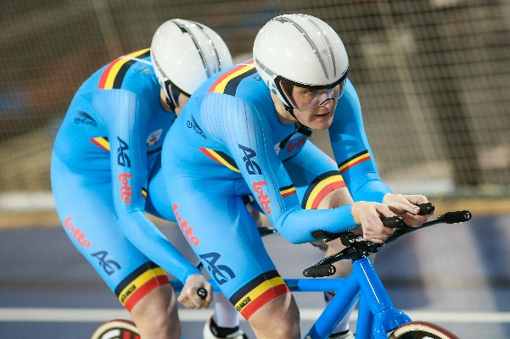
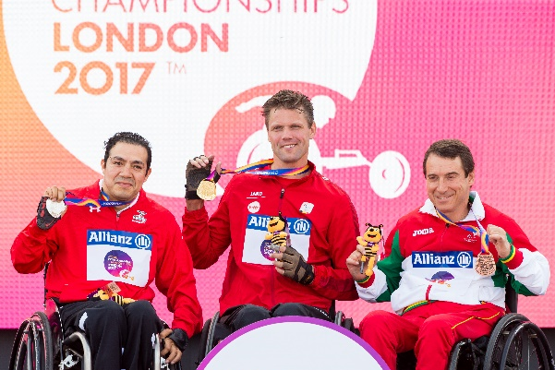
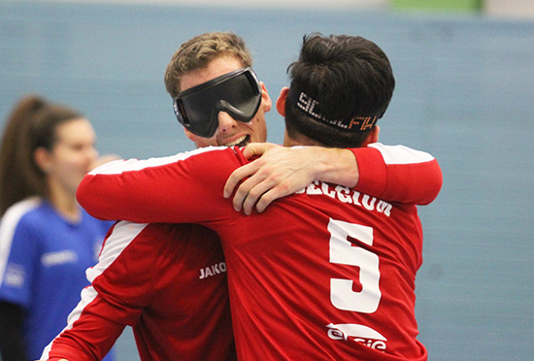
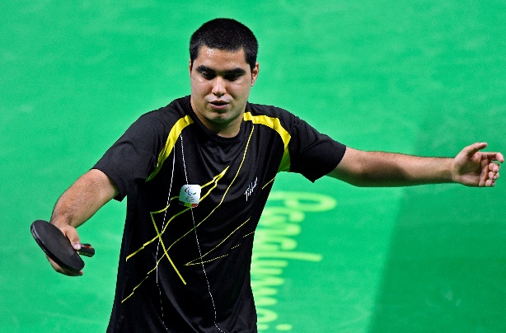
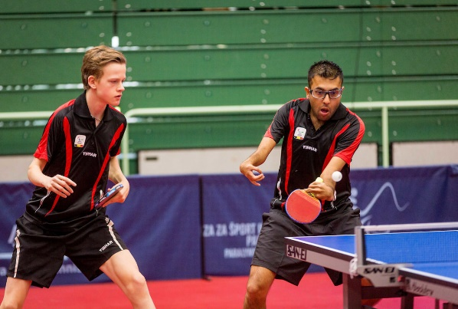
Top results 2017
Eléonor & Chloé Sana
Alpine Skiing World Championships
Visually impaired
Silver downhill + Bronze Super G
Diederick Schelfhout
UCI ParaCycling Track World Champ’s
Cycling C3
Bronze medal 3km pursuit
Griet Hoet & Anneleen Monsieur
UCI ParaCycling Track World Champ’s
Visually impaired
Bronze 3km pursuit
Joachim Gérard, Gert Vos, Jef Vandorpe
ITF Wheelchair tennis World Team Cup
Bronze medal
Peter Genyn
Para Athletics World Championships
T51 – Tetraplegic
Double gold 100 & 400m sprint
Men’s national team goalball
IBSA Goalbal European Championships
Bronze medal
Florian Van Acker
ITTF Para Table Tennis Euro’s
Bronze medal singles (ID)
Laurens Devos
ITTF Para Table Tennis Euro’s
Gold medal singles
Laurens Devos – Ben Despineux
Gold medal team competition

Slide 8
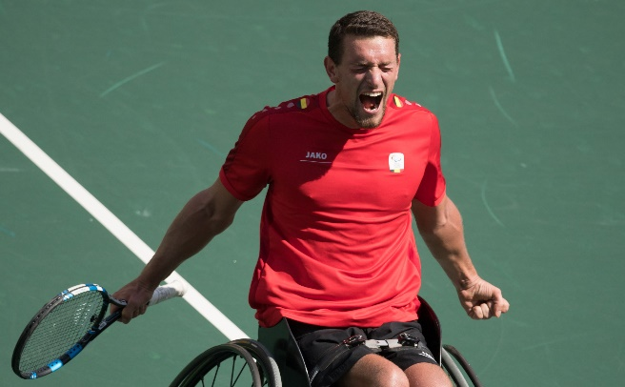
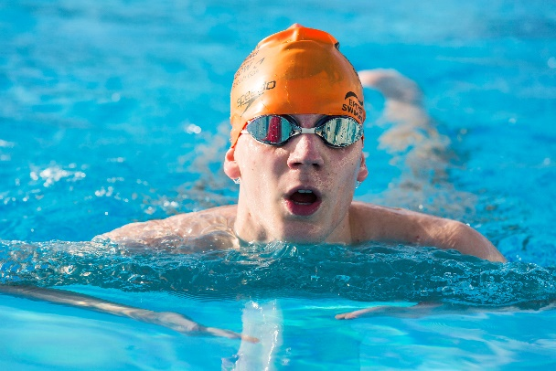
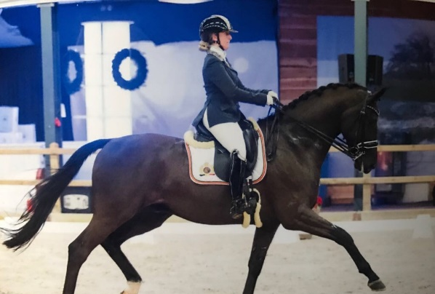
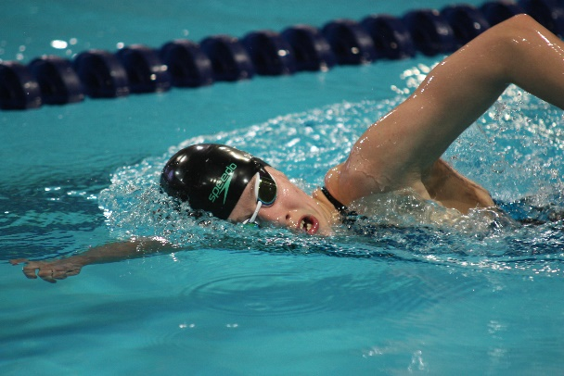
Joachim Gérard
Masters Wheelchair tennis
Bronze medal
Aymeric Parmentier
Para Swimming World Championships
Bronze 100m breaststroke (ID)
Yannick Vandeput
Para Swimming World Championships
Bronze 100m backstroke (ID)
Manon Claeys
Para-equestrian European Champ.’s
Silver medal Individual Test
Céline Deleuze
Para Swimming World Championships
Bronze 400m freestyle

Slide 9
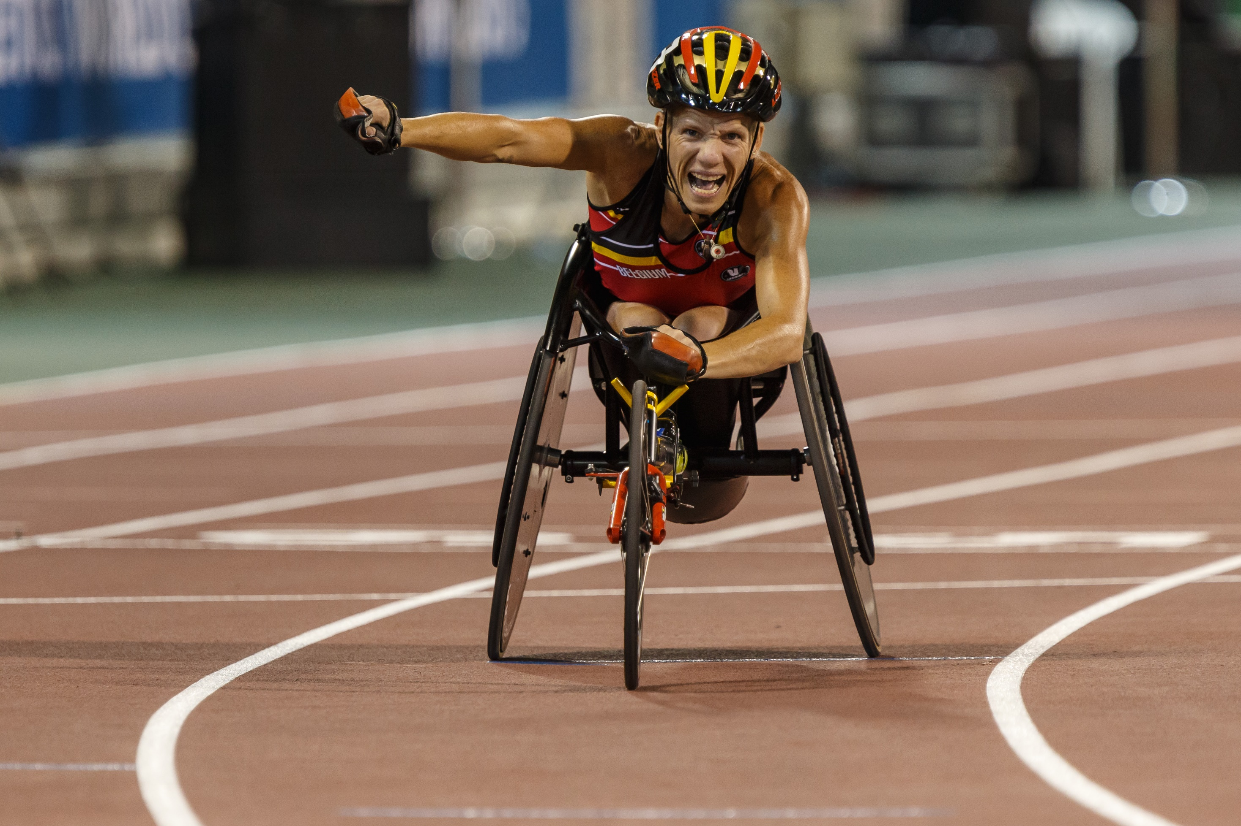
7 in 10 Belgians
“Paralympians changed my perception on disability in a positive way”
(Nielsen BPC 2016)
75% of Belgians
“Disability sports has a positive impact on perception of & equality for disabled.”
(Nielsen BPC 2014)

Slide 10
6 in 10 Belgians
…followed the Paralympics in the media. There was a 4.5 mio accummulated audience.
(Nielsen BPC – Sporza/RTBF 2016)

Slide 11
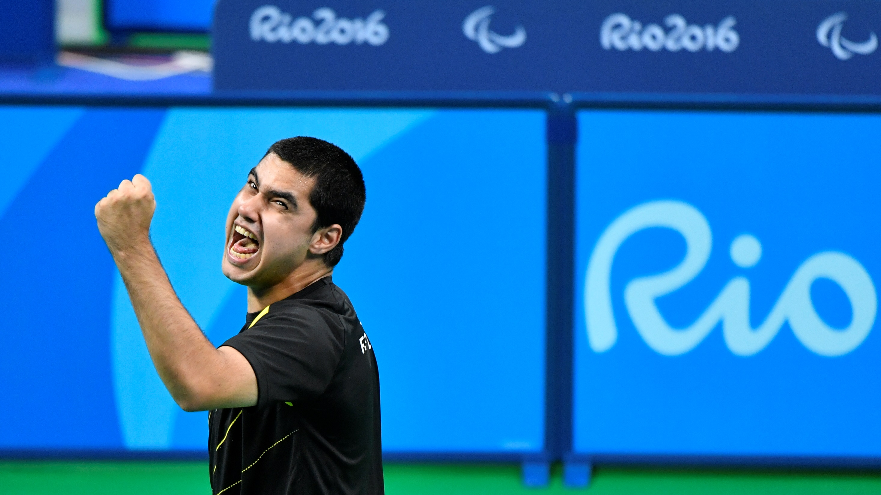
Potential
Of the non-interested : 35% due to lack of awareness, 33% due to lack of comprehension of classes.
(Nielsen BPC 2016)
1 in 3 Belgians
… is interested in
para-sports.
(Nielsen BPC 2016)

Slide 12
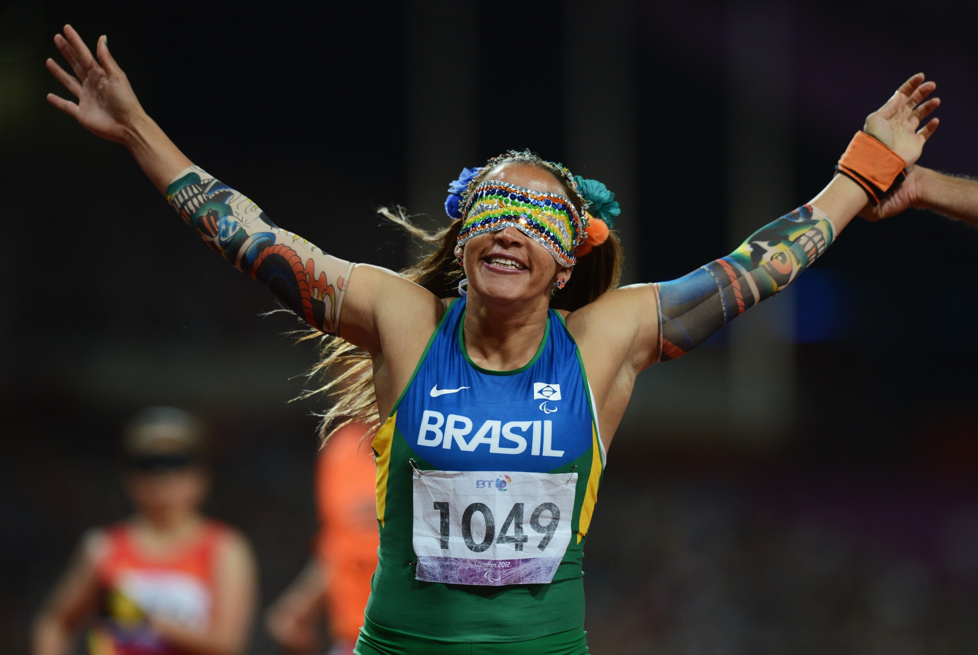
Para-sports has the most positive and emotional reaction to sports sponsorship.
(Nielsen 2016)

Slide 13
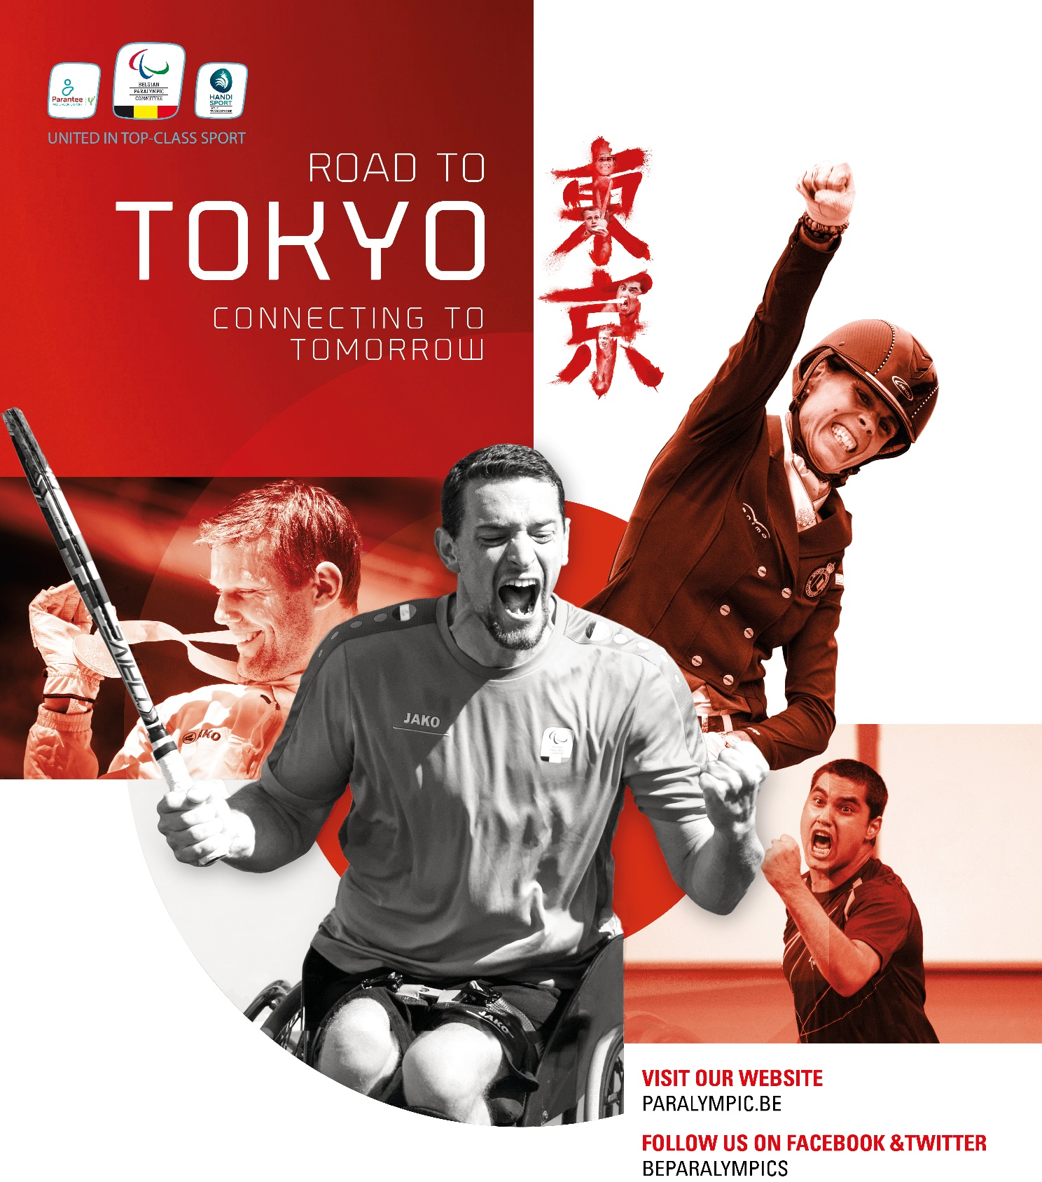
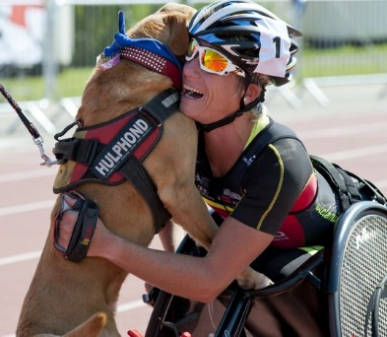
Road to Tokyo targets
50-100 delegations worldwide every year
25% growth of membership
40% growth fundings
50% growth of audiences
Support Tokyo Team in Belgium and in Tokyo : fan recuitment
Match up to Rio 2016 sporting success
→ Big impact of media partners on all targets

Slide 14
B2C : Changing perception
B2B
Athlete representations
Paralympic Forum : CEO’s
B2E
Paralympic team building
Athlete testimonials
Volunteering
Network events with athletes
Events from grassroots to promoting the Paralympic Games
Sensitizing campaigns
Media partnerships & packages

Slide 15
Organisation and support of +10 international sports competitions in Belgium every year
Several youth sport events, talent days, try-out events, …
Promotion activities at the biggest expo’s in Belgium
Revalidation centra projects: offer sports to help in the rehabilitation process of disabled
Yearly Belgian Championships per sport
Regulate (local) competitions in different sports
Inclusive sports : collaboration with able-bodied federations to reach more and more sportsmen/women

Slide 16
Games promotion events

Slide 17
Paralympic Team promotion events

Slide 18
Inspiring, sensitizing campaigns in-between Games
Regional, stimulating campaigns to get disabled to practice sports

Slide 19
Games years campaigns

Slide 20
Collaboration / Besoins

Slide 21
Offer disabled all the opportunities to excell in their sports, for them to become a source of inspiration for the Belgian society thanks to their performances.
→ Athlètes source d’inspiration
→ Retour partenaires BPC
→ Promotion valeurs

Slide 22
Campagnes
2 moments-clé campagnes télé
2018 : ‘naissance’ Paralympic Team Belgium
2019 = phase street marketing
2020 : campagne participation Tokyo 2020
Focus sur 2 campagnes/années
Budget en fonction de ?

Slide 23
Paralympic Team Belgium
Nouveau produit pour communication grand public
Accentue collaboration des 3 entités du Mouvement paralympique
Belgian Paralympic Committee (coupole)
Wall.-Brux. : Ligue Handisport Francophone (Adeps)
Flandres : Parantee (Sport Vlaanderen)
Personification ‘excellence, ‘inspiration’ des athlètes Paralympiques
Recrutement de supporters

Slide 24
Paralympic Team Belgium
Lancement septembre
Evénement Parc Cinquantenaire
Clip social + télé → importance collaboration
Print + digital
Message :
Nous créons nouveau produit
Découvrez les athlètes et leurs histoires
Excellence de quelques-uns, capable d’inspirer le plus grand nombre

Slide 25
Campagne Tokyo
Plusieurs phases àpd avril 2019
Focus print + street marketing en 2019
2020 : équipe Tokyo / participation
Espace télé/radio/digital = !
Période focus = entre JO et JP

Slide 26
Partenaires
Situation actuelle

Slide 27
Next Generation Heroes
Discussion en cours
Maison de prod. ~ 4à5 partenaires de BPC
Films de 2minutes high-quality sur vie d’athlètes
Recherche de collaboration avec partenaires média BPC

Slide 28
Return RTBF
Droits (~éditorial)
Visibilité événements
Visibilité campagnes
Accès/droits images athlètes
Canaux de communication
B2B events
Invitations Jeux Paralympiques

Slide 29
Anne d’Ieteren
President
anne.dieteren@paralympic.be
Guillaume Gobert
Marketing & Media Manager
guillaume.gobert@paralympic.be

